Slide 1
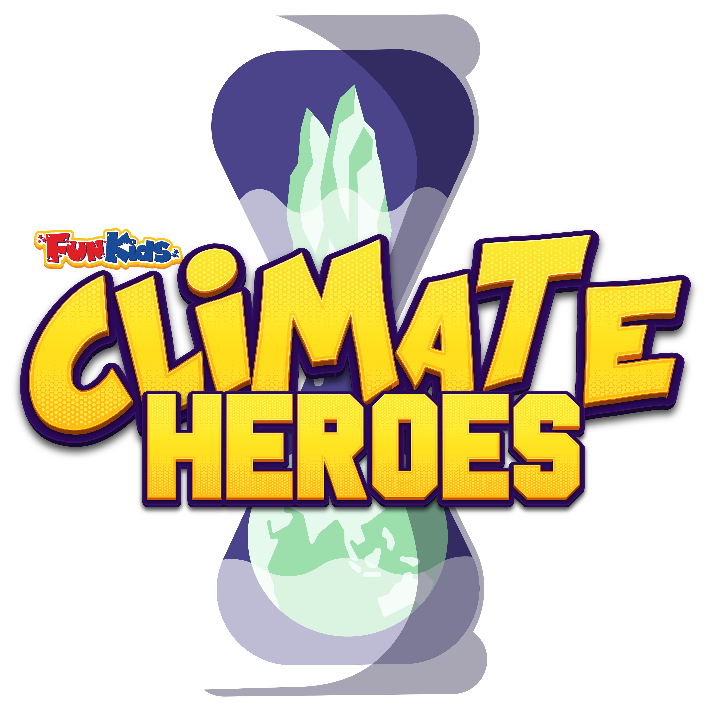
ECO ASSEMBLY

Slide 2
What is climate change?
WALT: In this assembly we are going to look at what climate change is and how humans are adding to it! Then we’re going to learn how we can help reduce the impacts of climate change and what scientists are doing to help
Weather and climate are different things – here’s a video from Marina Ventura who is going to show the difference between weather and climate.
Notes:
WALT: In this assembly we are going to look at what climate change is and how humans are adding to it! Then we’re going to learn how we can help reduce the impacts of climate change and what scientists are doing to help
What is climate change?
Sometimes when people say the climate is getting warmer it sounds quite nice – most of us would love a warm summer but it isn’t that simple.
Weather and climate are different things – here’s a video from Marina Ventura who is going to show the difference between weather and climate.
Show Marina Ventura Video from Slide Show https://youtu.be/ciL0LVG3Avs

Slide 3
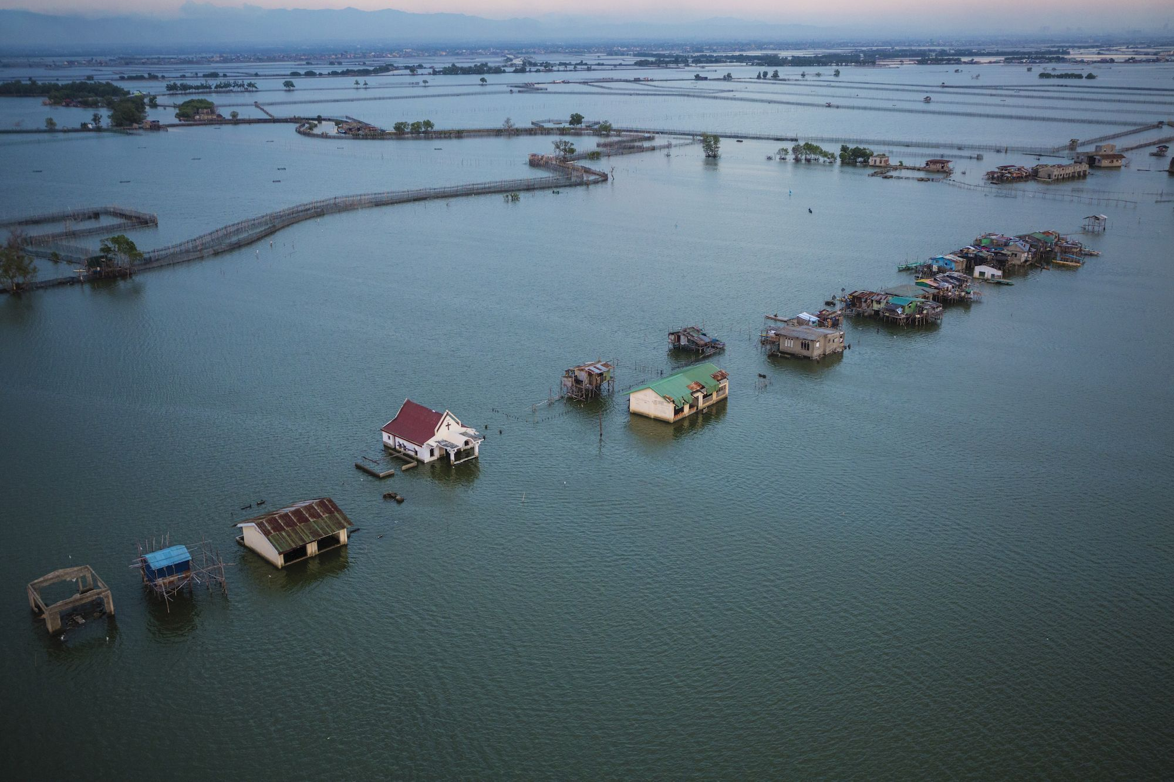
everything ON EARTH IS CONNECTED
If glaciers melt in Antarctica then Sea Levels will rise on other places on Earth
Notes:
Everything on Earth is connected. For example, as the climate warms this is melting glaciers in Antarctica, this has a knock on impact as it causes rising sea levels which can lead to floods in other places on Earth. So a nice hot English summer isn’t as nice as it sounds when it impacts so many other things.
Places near the sea could be at risk because they are near high tide causing entire nations to disappear. It also affects our fresh drinking water supply as sea water comes into contact with fresh water.
Let’s conduct an experiment to see how melting glaciers cause the sea level to rise.
EXPERIMENT: Let’s put a block of ice in a Tupperware with a cup of water and mark on the Tupperware with a marker where the water level is….let’s revisit this at lunch and see where the level is as the ice melts. (You can improve this experiment further by placing a pyramid at the bottom of the Tupperware submerged and marking where the water reaches – explain to children that as the water rises it means part of the pyramid will become underwater just like countries will if the sea level rises where they are.

Slide 4
LET’S CONDUCT AN EXPERIMENT
EXPERIMENT: Fill a container with ice so that you have a mountain of ice like an ice cap! Fill the container with water and mark a line where the water level is – this is your current sea level….let’s revisit this later and see where the level is as the ice melts.
Notes:
EXPERIMENT: Let’s put a block of ice in a Tupperware with a cup of water and mark on the Tupperware with a marker where the water level is….let’s revisit this at lunch and see where the level is as the ice melts. (You can improve this experiment further by placing a pyramid at the bottom of the Tupperware submerged and marking where the water reaches – explain to children that as the water rises it means part of the pyramid will become underwater just like countries will if the sea level rises where they are.
Other places will face droughts caused by climate change making the weather very hot and dry. A drought is when we don’t have enough water needed to drink or grow food.

Slide 5
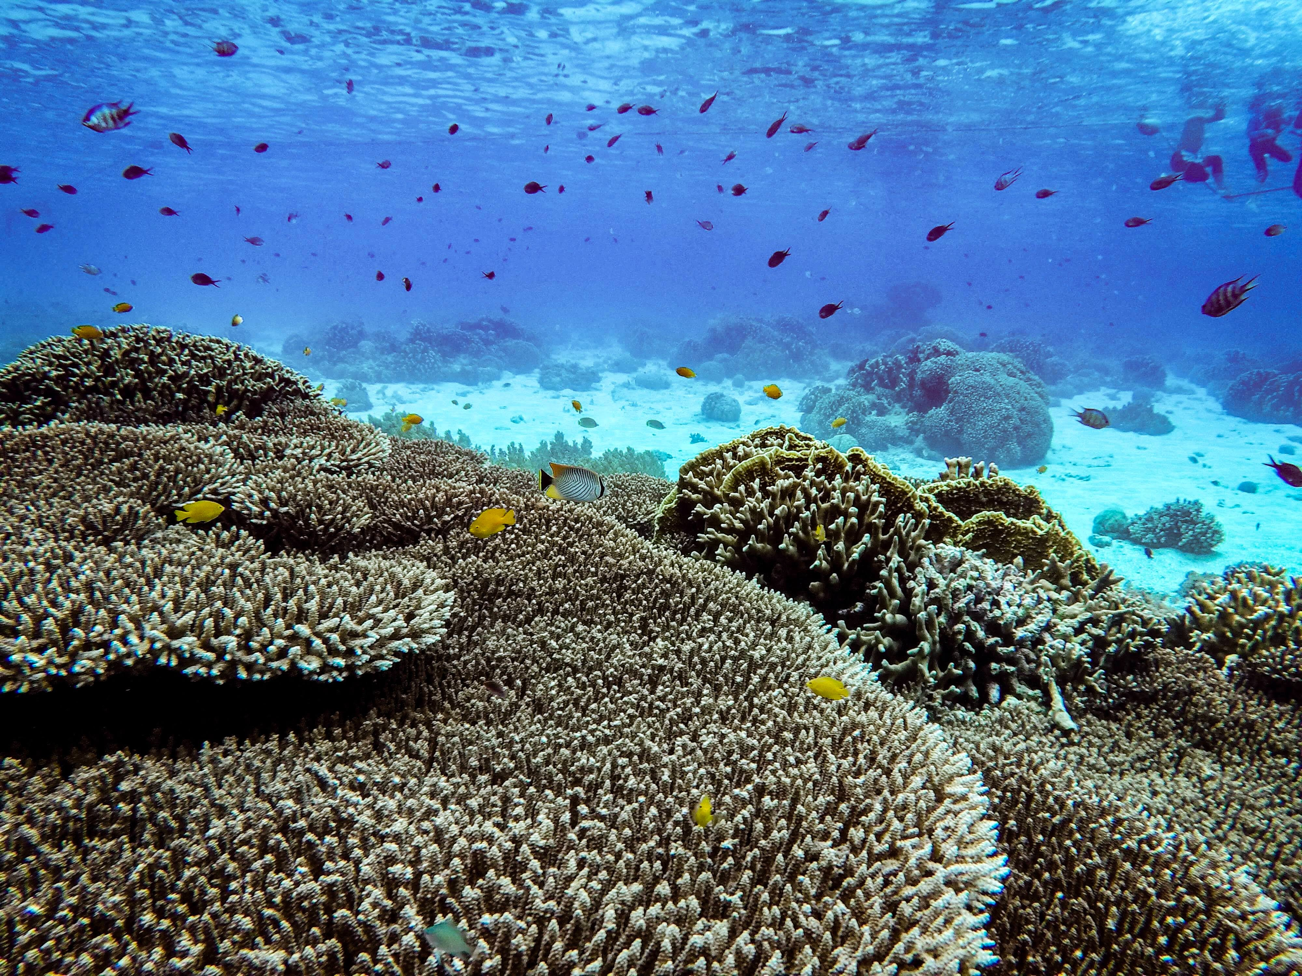
CORAL BLEACHING: How climate change has changed our earth already

Slide 6
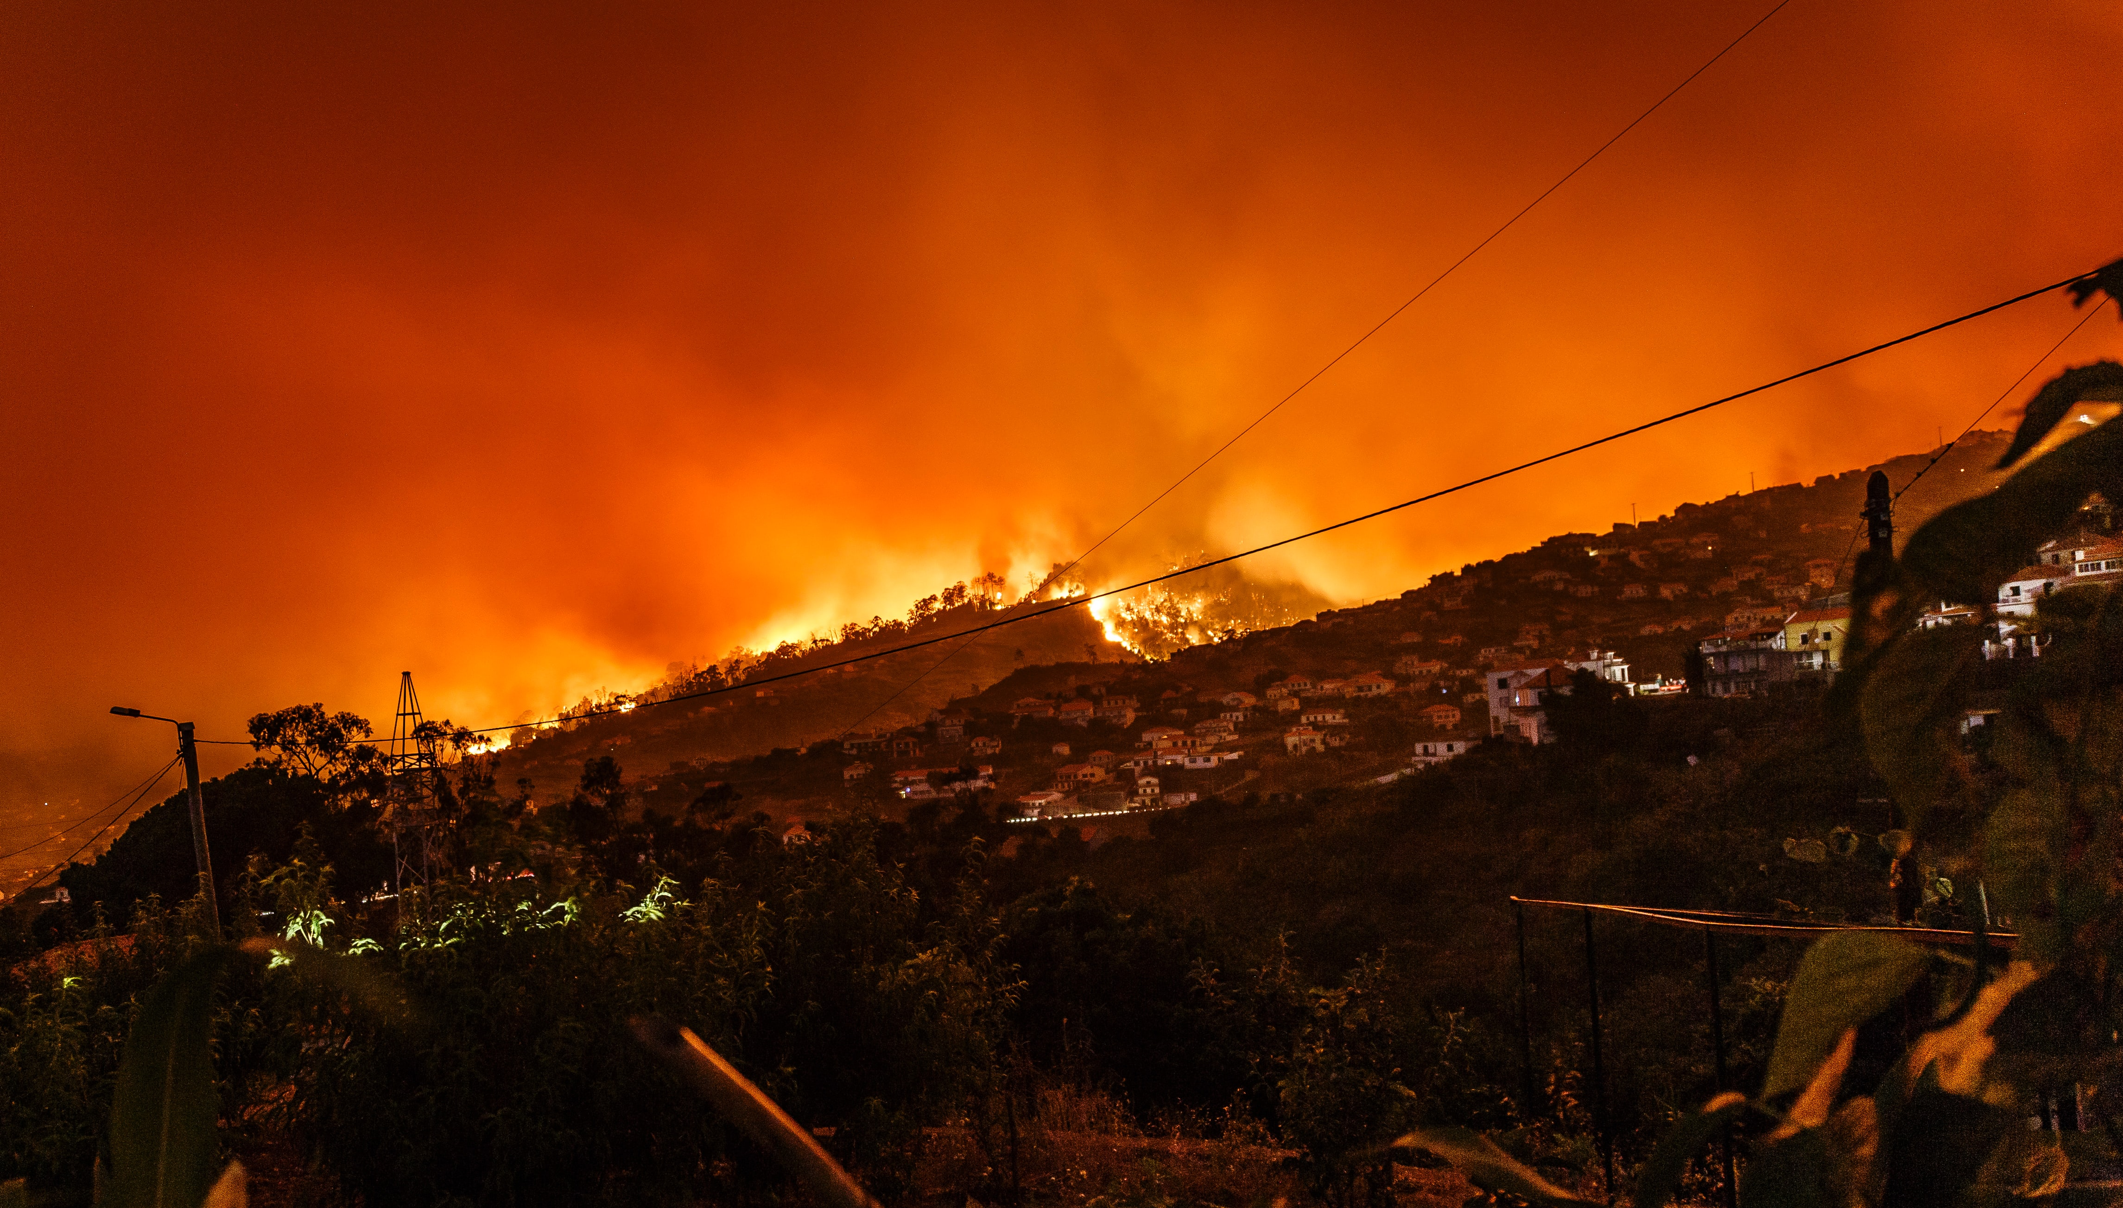
WILDFIRES: How has climate change changed our earth already
Colorado, USA 2020
Portugal 2017
Notes:
Climate Change is a big factor behind Wildfires in California and Australia that you might have seen on the news last year.
Here are some pictures of how climate change has changed our world already
PICS: Great barrier reef / wildfires in Australia / Bangladesh.
Coral Reef Bleaching: The main cause of coral bleaching, which is when the coral loses its colour, is climate change. A warming planet means a warming ocean, and a change in water temperature—as little as 1 degree—can cause coral to drive out algae which colours it. Coral may bleach for other reasons for example from pollution.
Wildfires: Climate change increases the risk of the hot, dry weather that is likely to fuel wildfires. Extreme fire weather events including increased lightning and strong winds, are also becoming more common under climate change.
Flooding in Bangladesh: flooding in Bangladesh is predicted to become more extreme due to cyclonic storm surges and rising sea levels. ... Much of the nation is exposed, as 80% of Bangladesh is flood plain meaning it is at a big risk of flooding. The majority of the country a metre or less above sea level.
To protect humans, wildlife and our planet we need to stop climate change happening further.

Slide 7
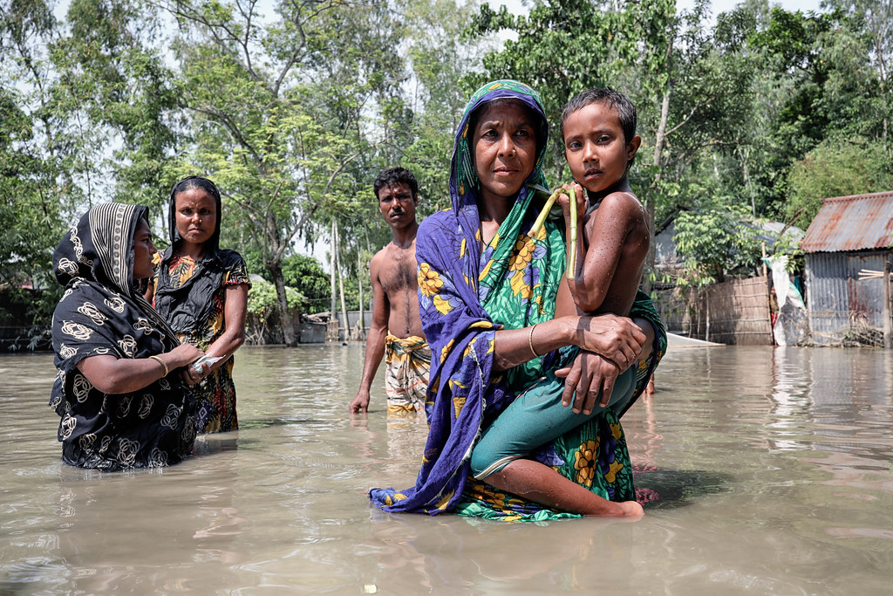
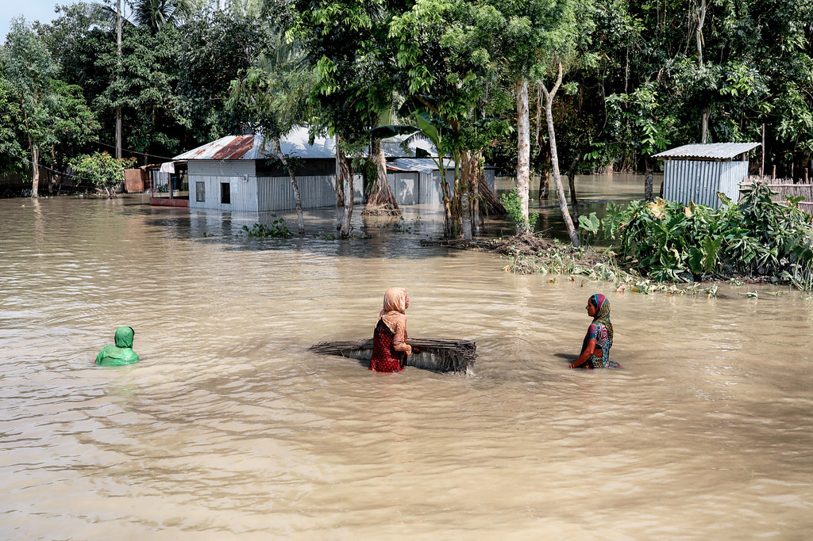
flooding: How climate change has changed our earth already
Bangladesh
Notes:
Flooding in Bangladesh: flooding in Bangladesh is predicted to become more extreme due to cyclonic storm surges and rising sea levels. ... Much of the nation is exposed, as 80% of Bangladesh is flood plain meaning it is at a big risk of flooding. The majority of the country a metre or less above sea level.
To protect humans, wildlife and our planet we need to stop climate change happening further.

Slide 8
What is causing climate change? : the greenhouse effect
Greenhouse Gases in Earth’s atmosphere block heat from escaping.
This is called the greenhouse effect because they keep Earth warm like the glass in a greenhouse keeps plants warm.
The main gases responsible for the greenhouse effect include carbon dioxide, methane, nitrous oxide, and water vapor.
Notes:
There are lots of factors that contribute to Earth’s climate. However, scientists agree that Earth has been getting warmer in the past 100 years due to human activities.
Certain gases in Earth’s atmosphere block heat from escaping. This is called the greenhouse effect because they keep Earth warm like the glass in a greenhouse keeps plants warm. The main gases responsible for the greenhouse effect include carbon dioxide, methane, nitrous oxide, and water vapor.
Optional mini experiment – can be done as part of assembly or classes may choose to do it at another time. Place one thermometer in a vase vs a thermometer not in vase and see which one has a higher temperature after 1 hour.

Slide 9
What are the main greenhouse gases?
Water vapour
This is water in its gas form. Normally water vapour in the air comes from the sea and rivers. Power stations also release a lot of water vapour. As the planet gets warmer more water turns into water vapour.
Sulphur dioxide
Sulphur dioxide is pollution that's created from fuels used in power plants and vehicles.
Nitrous oxide
Nitrous oxide does occur naturally and is actually very important to the nitrogen cycle. However humans are making too much of it through vehicles, power stations and to put on crops that humans and farm animals eat.
Carbon dioxide (CO2)
Carbon dioxide is all around us. In nature humans and animals produce it when they breathe and volcanoes emit it too. Burning fossil fuels and deforestation has meant we are adding extra CO2 to the air and in massive amounts.
Methane
Methane is a natural gas emitted by animals (including humans) when we trump! Methane is also produced by wetlands and volcanoes. Humans are increasing to the methane in the air through of cattle farming, landfill waste and mining coal.
Notes:
What are the greenhouses gases?
Carbon dioxide (CO2)
Carbon dioxide is all around us. In nature humans and animals produce it when they breathe and volcanoes emit it too. Burning fossil fuels and deforestation, when forests are cut down, has meant we are adding extra CO2 to the air and in massive amounts. There's more carbon dioxide in the atmosphere today than at any time in the past three million years.
Methane
Methane is a natural gas emitted by animals (including humans) when we trump! Methane is also produced by wetlands and volcanoes. Humans are increasing to the methane in the air through of cattle farming, landfill waste and mining coal. Together with CO2, it's one of the main greenhouse gases causing global warming.
Water vapour
This is water in its gas form. When you boil a kettle you will see steam which is water vapour. Normally water vapour in the air comes from the sea and rivers. Power stations also release a lot of water vapour. Also as the planet gets warmer more water turns into water vapour.
Sulphur dioxide
Sulphur dioxide is pollution that's created from fuels used in power plants and vehicles.
Nitrous oxide
Nitrous oxide does occur naturally and is actually very important to the nitrogen cycle. However humans are making too much of it through vehicles, power stations and to put on crops that humans and farm animals eat.

Slide 10
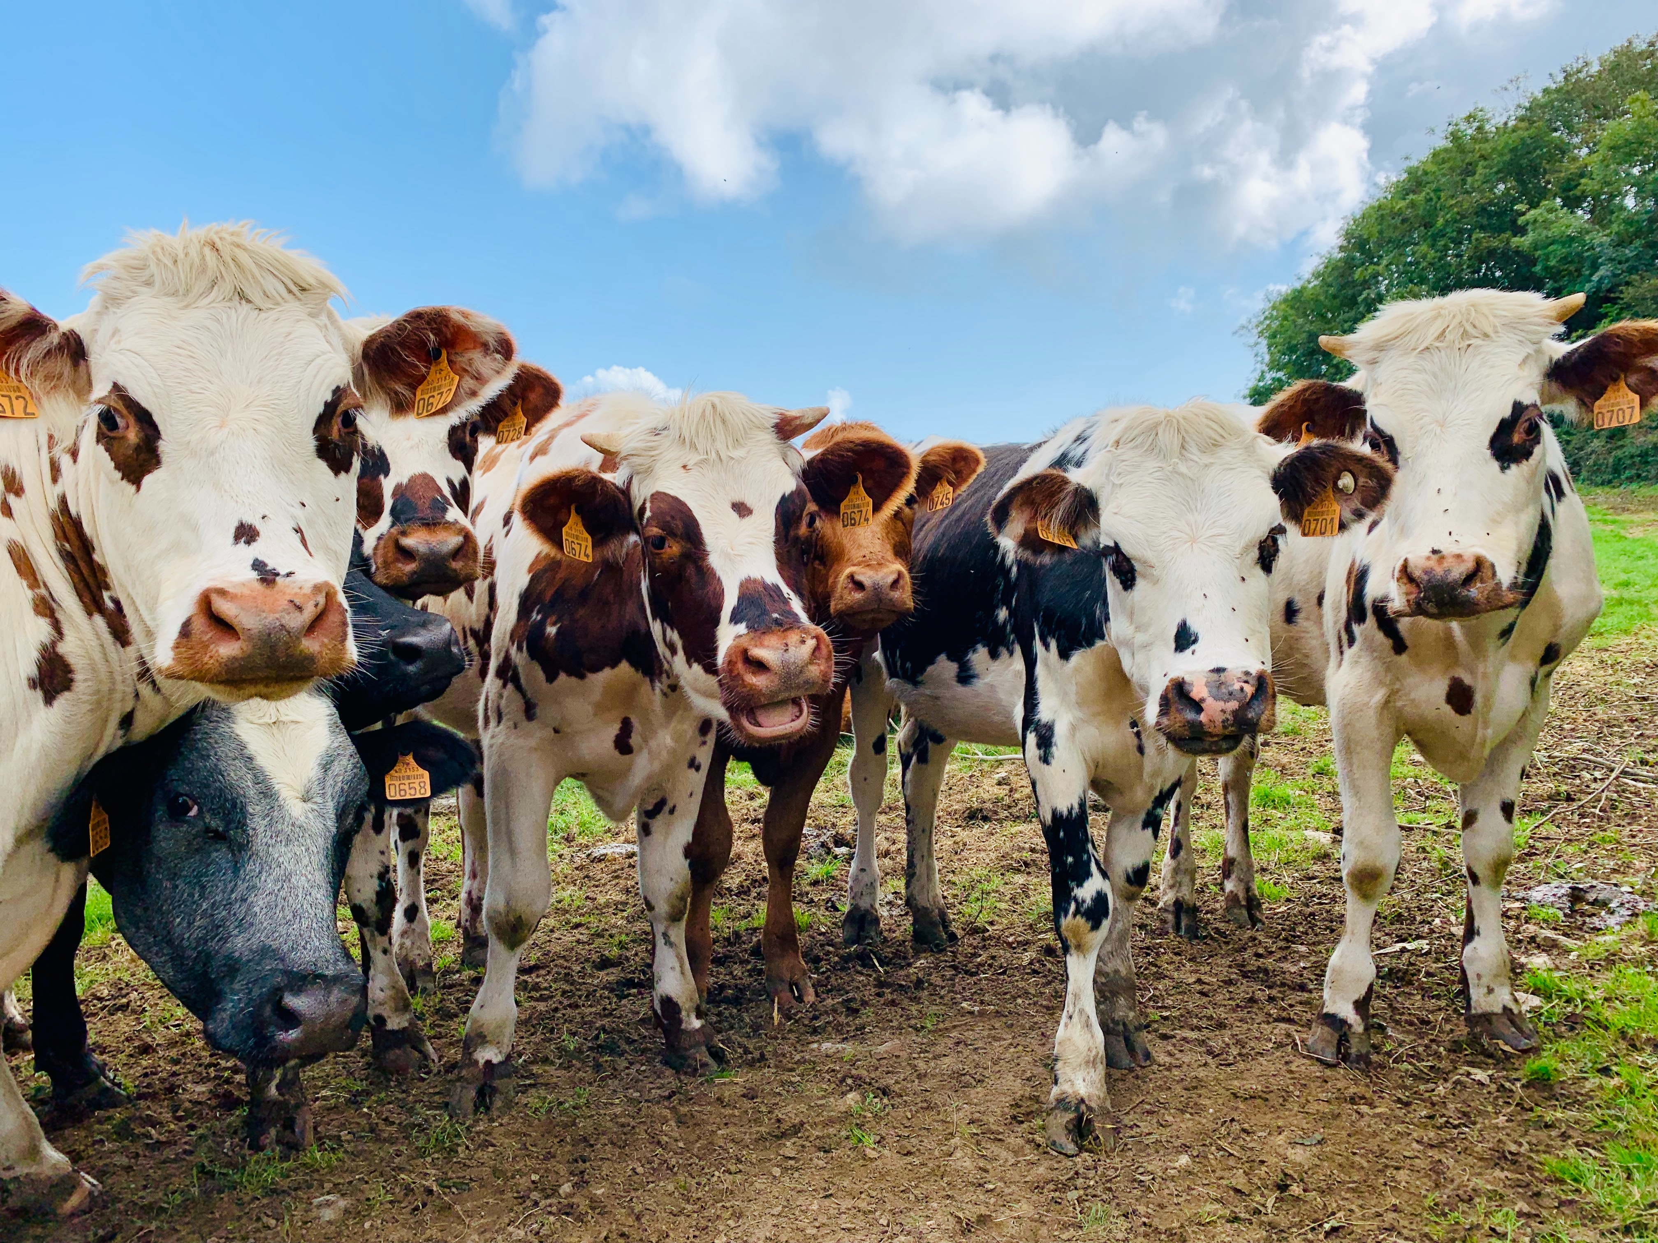
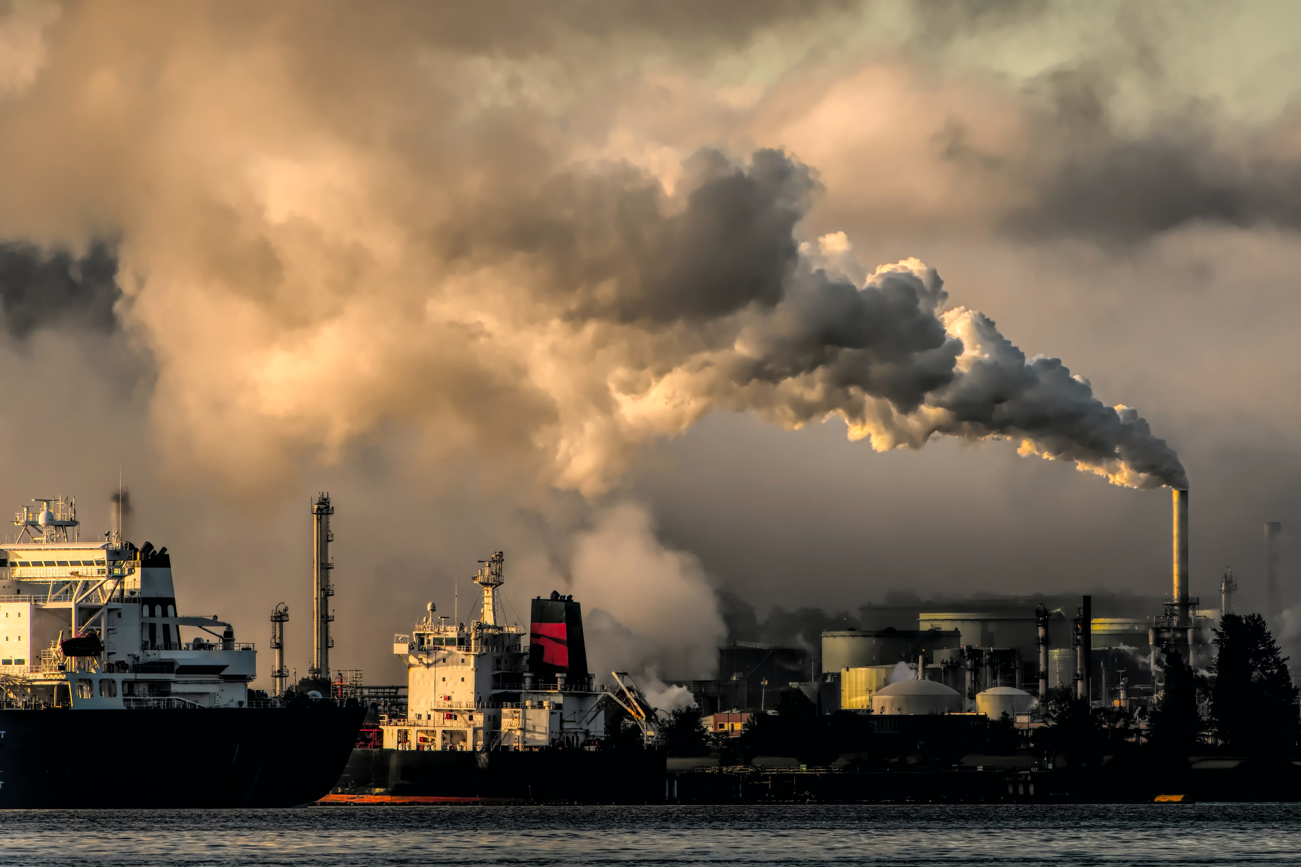
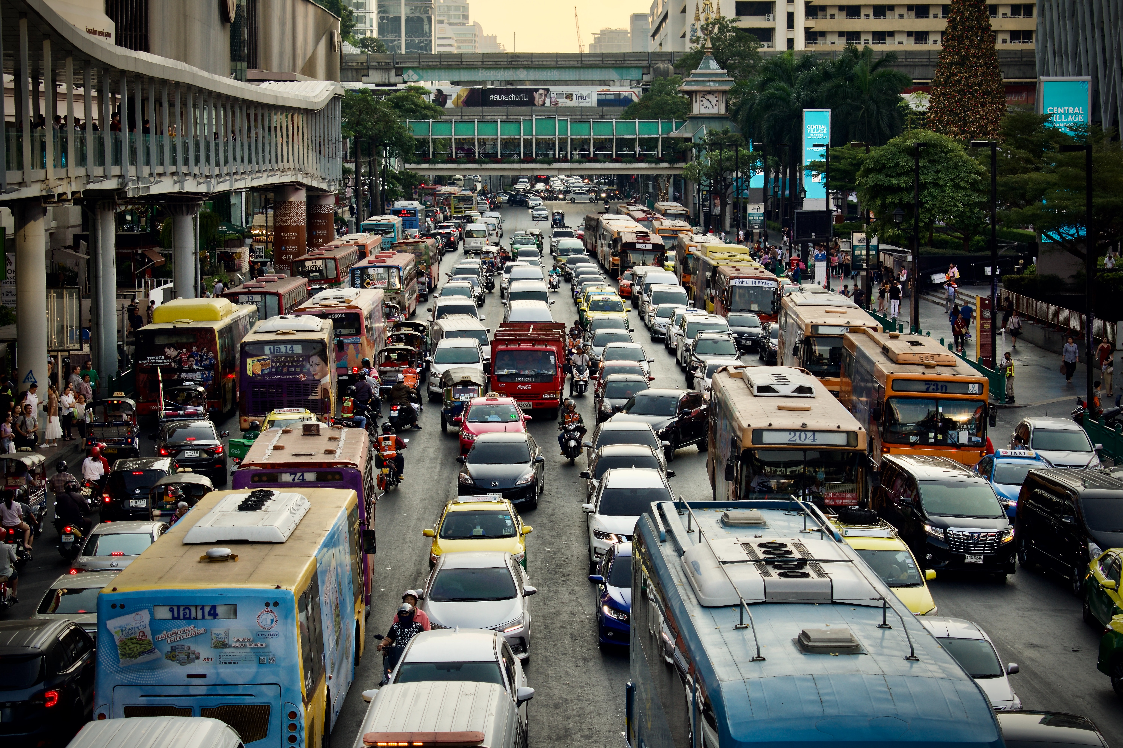
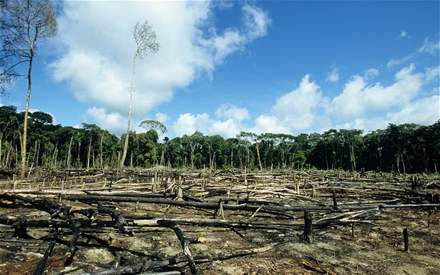
How do humans create greenhouse gases?
When animals like cows trump they produce methane – a very powerful greenhouse gas.
Half of the UK’s animal feed is imported – with lots coming from South America . This has been linked to deforestation in the rainforest which is being burned to create land for cattle, animal feed and palm oil. Brands like Tesco Sainsbury's, Asda, Lidl and other major supermarkets have been exposed as selling meat fed on illegally grown soy.
We burn fossil fuels to create 38% of our energy like electricity.
We also burn fossil fuels in planes, cars and other transport.
Plus there’s fossil fuels burning that we don’t see – such as to power factories that make clothes and toys.
Notes:
These gases occur naturally however Human activities are adding more to the atmosphere through activities such as burning fuel to power factories and cars, farming animals. These changes cause the atmosphere to trap more heat than it used to, leading to a warmer Earth.
We are also getting rid of the things that help absorb greenhouse gases from the atmosphere like the rainforest by burning it to create land for cattle, animal feed and palm oil.
Sometimes we might not see the impact we make for example when we turn on the car we don’t immediately see the impact the fossil fuels have or when we buy a new coat we don’t think about the factory burning fossil fuels that’s made it. When we eat our lunch we don’t think about the process of growing plants, feeding the animals and transporting the food to the supermarket but almost everything we do impacts the climate at different levels.

Slide 11
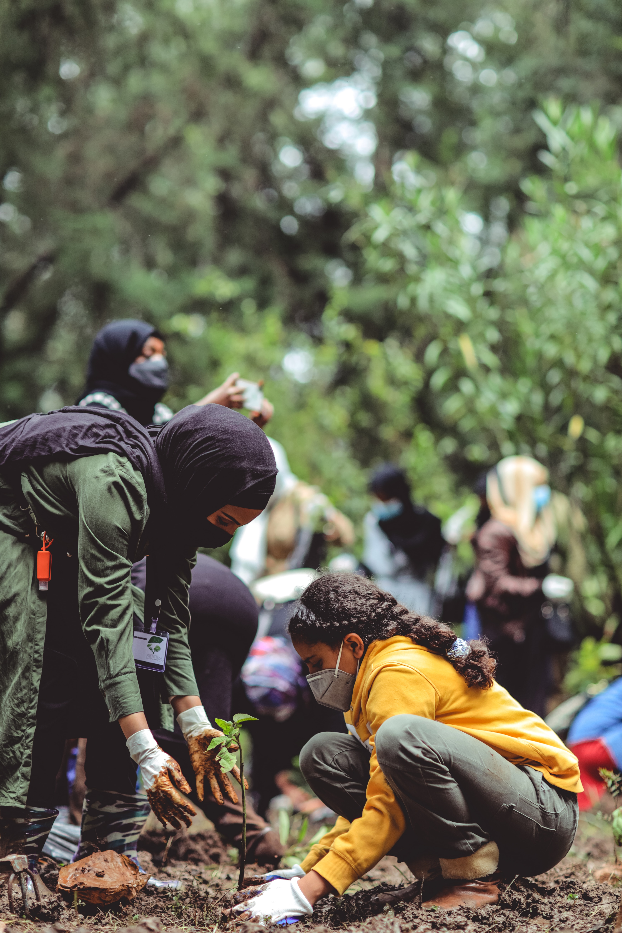
Reducing our personal carbon footprint : WHAT CAN WE DO?
Walk to school
Holiday in the U.K instead of flying abroad
Buy less stuff
Plant a tree
Eat less meat
Shop second hand
Switch off electronics when you’re not using them
Notes:
What can we do to reduce our personal carbon footprint?
One thing you can do can reduce your personal carbon footprint. As you now know the different actions we take have different impacts on the environment.
Walk to School
Switch up using a vehicle that uses fossil fuels and walk or cycle instead. Not only will the environment thank you but you’ll also be keeping healthy.
Holiday in the U.K. instead of abroad
When an airplane flies it releases CO2 into the air. Flying from London to New York and back generates about 986kg of CO2 per passenger. In Paraguay in South America this is more than the average person’s carbon footprint in an entire year.
Travelling from London to Rome carries a carbon footprint of 234kg of CO2 per passenger – more than the average produced by people in 17 countries over a year.
Buy less stuff
We mentioned it in the 5Rs but it’s worth saying again. If pretty much everything we do creates emissions then choosing to use a bag we already have instead of buying a new one, playing with a toy we have and repairing things that are broken instead of replacing them can have a really reduce our carbon footprint.
Plant a tree
Trees breathe in CO2 and turn it into oxygen – plant a tree and you can help suck that carbon dioxide out of the atmosphere!
Reduce how much meat you eat/ go veggie
Food’s carbon footprint is the greenhouse gas emissions produced by growing, rearing, farming, processing, transporting, storing, cooking and disposing of the food you eat.
Meat, especially lamb and beef, has a high carbon footprint. It is estimated a vegetarian diet has half the carbon footprint of a meat eater’s diet and that vegans have the lowest carbon footprint of all diets.
Think about eating less meat – maybe have a veggie school dinner option instead of meat or find ways to reduce the meat you put into something by adding an extra vegetable to your meal like a sweet potato.
If vegetables are locally grown that’s even better because it will have less transportation emissions. Look for the British flag on vegetables in the supermarket!
Wear secondhand clothes
Clothes create a lot of carbon emissions when they are made, plus some fabrics like polyester are made from plastic which means they release little pieces of plastic into the oceans when they are washed and pollute the sea.
By buying a secondhand coat instead of a new one you are stopping a brand-new item being made and not adding to your carbon footprint.
Switch off things when you’re not using them
Make sure you turn off the lights in the classroom before you go to lunch, don’t leave the oven on for an hour before you put your pizza in and try and find ways to use less electricity.
The good thing about electricity is one day it might all be made from wind power and tidal power which means that no carbon emissions are pumped out. At the moment 46% of electricity comes from eco-friendly energy – these are known as renewable resources.
It’s important to know that in richer countries like the U.K our carbon footprint per person is usually bigger because more people go on holidays in planes, we generally have more clothes than poorer countries and more people can afford things like central heating – although this isn’t the case for everyone in our country. That’s why it’s really important richer countries help with climate change related disasters in poorer countries and use their money to fund research. Which brings us onto SCIENCE!

Slide 12
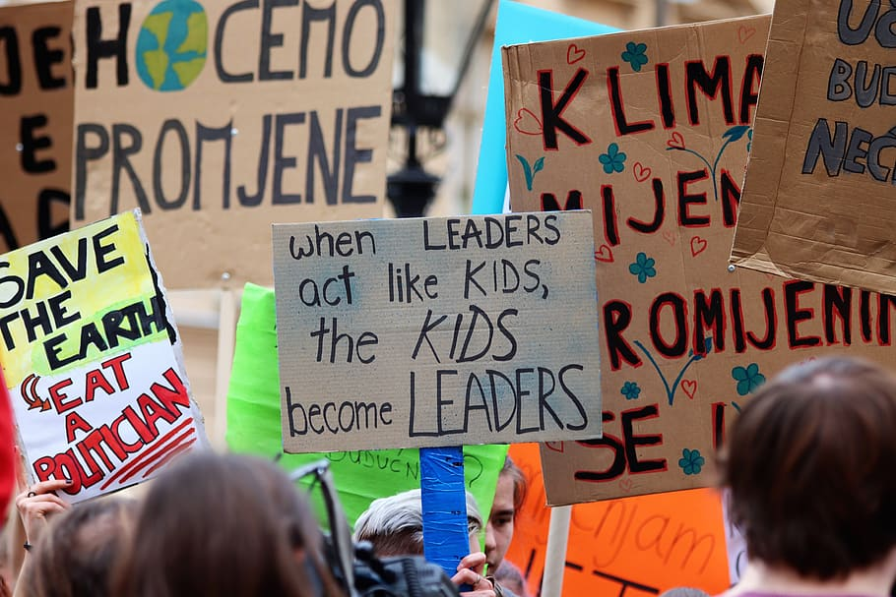
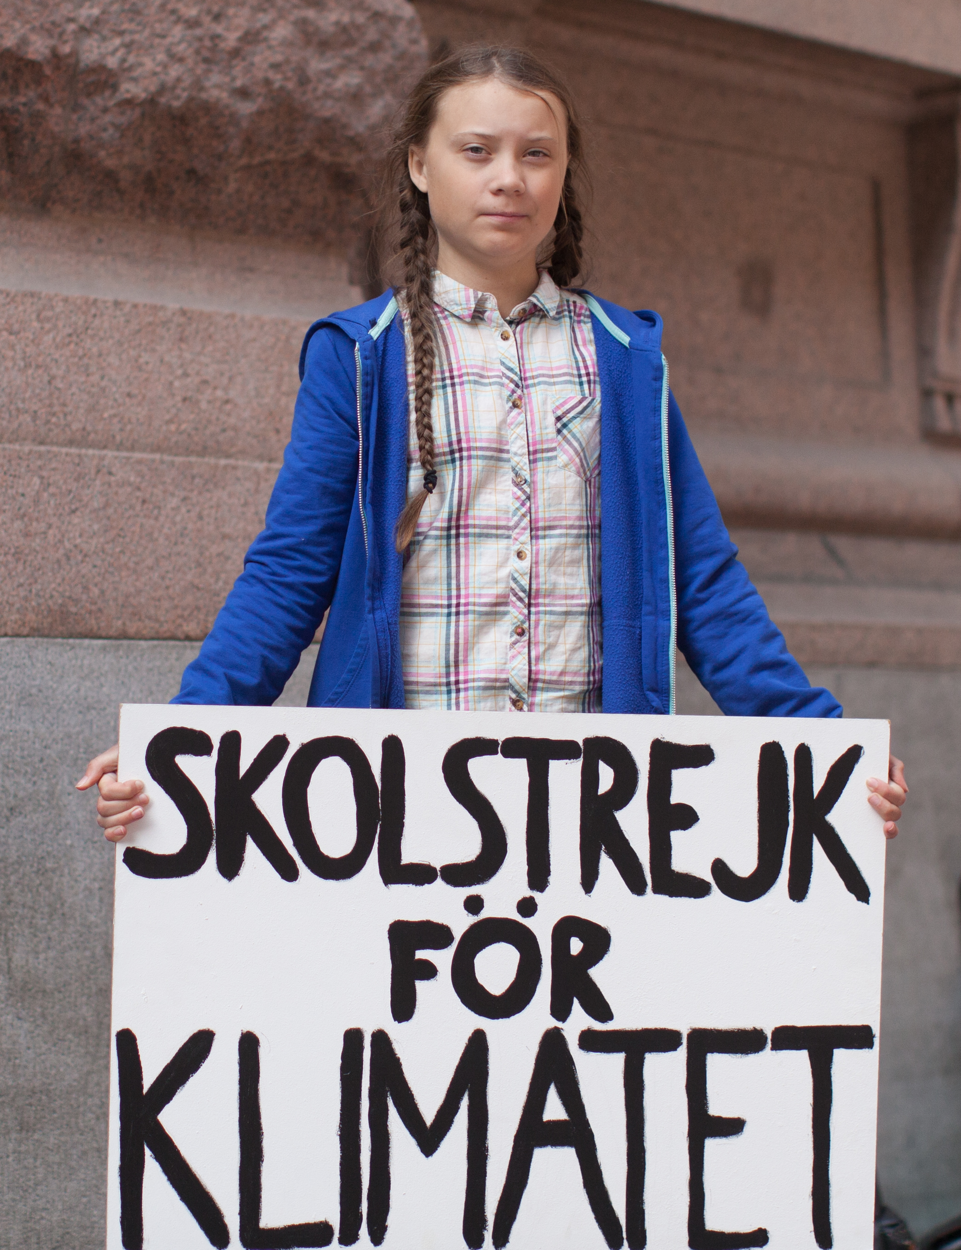
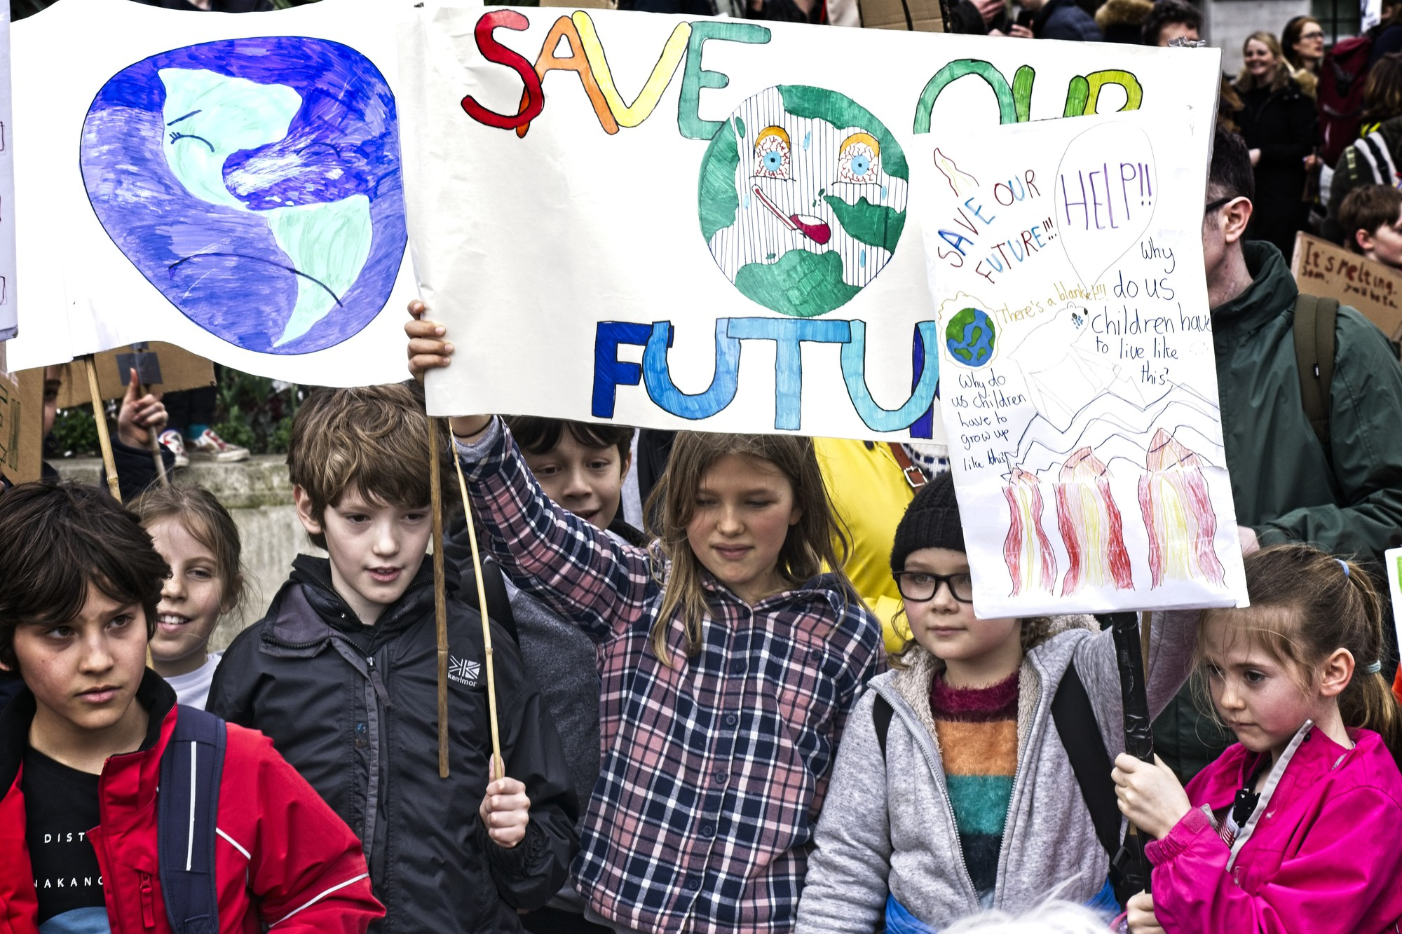
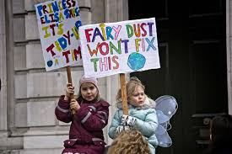
Can we stop climate change or is it too late? : PROTESTING AND GRETA THUNBERG
Notes:
Other people may be trying to convince the government, people or companies to make changes by protesting – like in the pictures on the slides.
Has anyone heard of Greta Thunberg? Who is she? (get kids to answer)
Answer: Greta is a Swedish environmental activist who challenges world leaders to take action on climate change.
Thunberg's activism, which means campaigning to create change, began by persuading her parents to adopt lifestyle choices that reduced their own carbon footprint. In August 2018, at age 15, she started spending her school days outside the Swedish Parliament to call for stronger action on climate change by holding up a sign reading School Strike for Climate. Soon other students started similar protests in their own communities. Together they organised a school climate strike movement under the name Fridays for Future.
So campaigning can be a really good way to try and create climate change action.

Slide 13
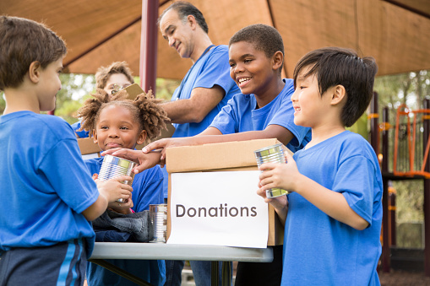
Can we stop climate change or is it too late?
Write a letter to your local MP and support charities who help those affected by climate change and campaign to save rainforests.
Notes:
Can we stop climate change or is it too late?
Some impacts of climate change are already happening, such as the coral bleaching and bushfires we saw at the start of assembly, but we can stop them getting worse and work to protect the planet, people and animals from further damage.
What can we do?
You might be too young to vote but that doesn’t mean you can’t tell your local MP or councilors your concerns and make sure they know Climate Change is a big concern for you– write a letter to them explaining why this issue is important to you!
Lots of politicians will be meeting at The 2021 United Nations Climate Change Conference, also known as COP26, in Glasgow between 31 October and 12 November 2021. You might want to write to your MP to ask the UK representatives to commit to change which can help slow climate change.
Other people may be trying to convince the government, people or companies to make changes by protesting – like in the pictures on the slides.
Has anyone heard of Greta Thunberg? Who is she? (get kids to answer)
Answer: Greta is a Swedish environmental activist who challenges world leaders to take action on climate change.
Thunberg's activism, which means campaigning to create change, began by persuading her parents to adopt lifestyle choices that reduced their own carbon footprint. In August 2018, at age 15, she started spending her school days outside the Swedish Parliament to call for stronger action on climate change by holding up a sign reading School Strike for Climate. Soon other students started similar protests in their own communities. Together they organised a school climate strike movement under the name Fridays for Future.
So campaigning can be a really good way to try and create climate change action.
Some places are already experiencing the impacts of climate change on their lives, you can support charities which help people suffering due to climate change such as action aid uk and also support campaigns to save the rainforest and protect the ocean which are really important to the Earth.

Slide 14
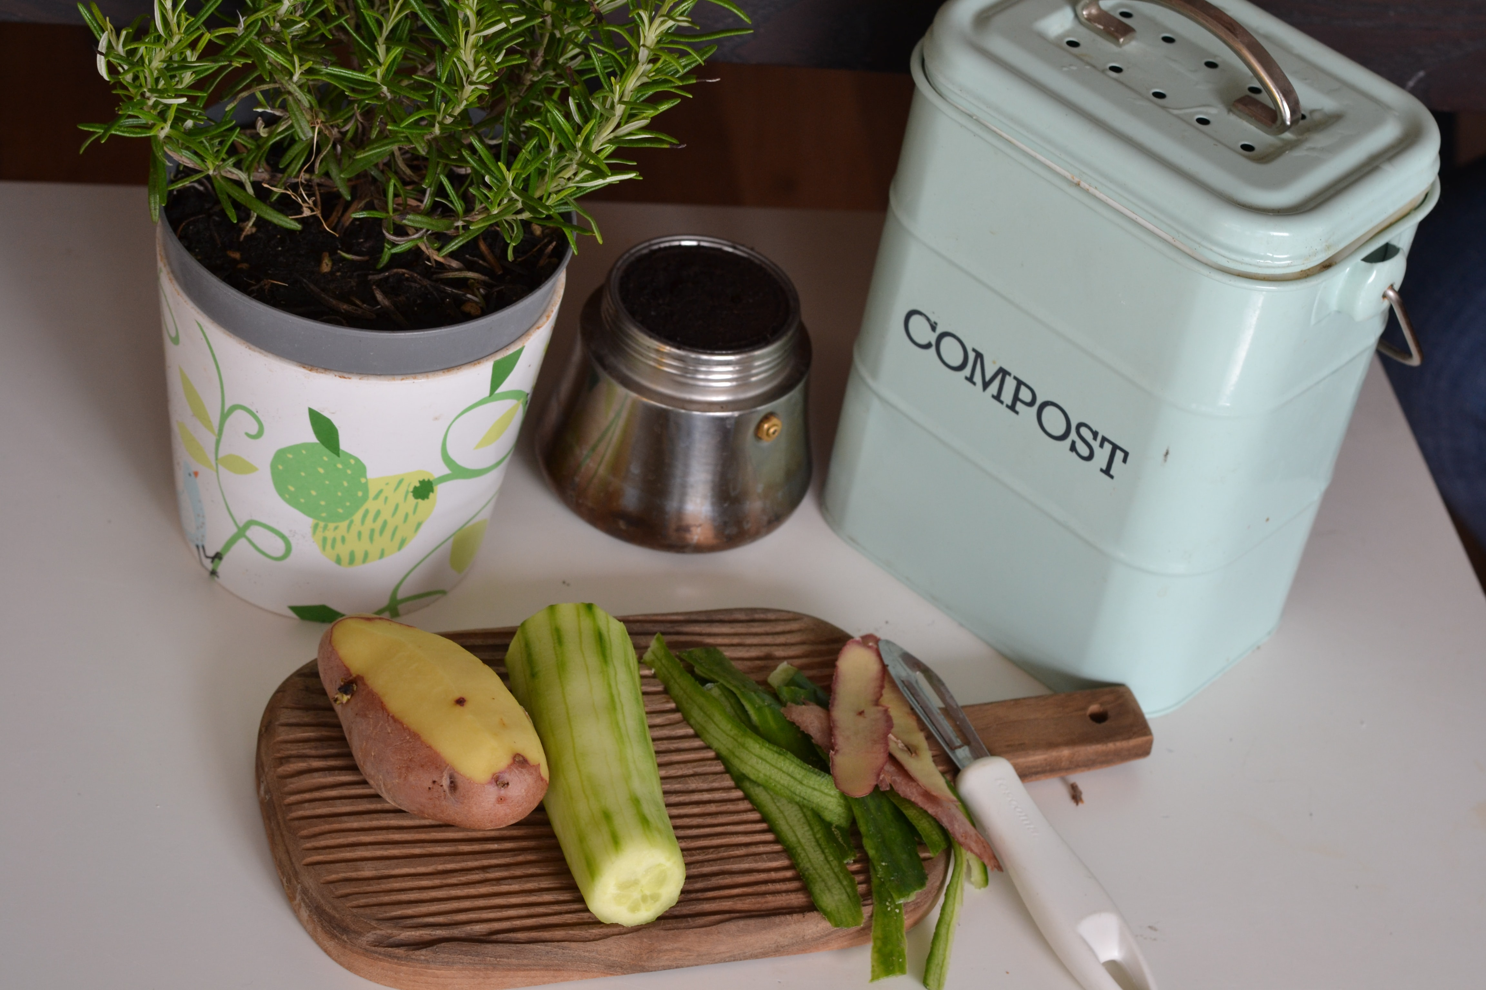
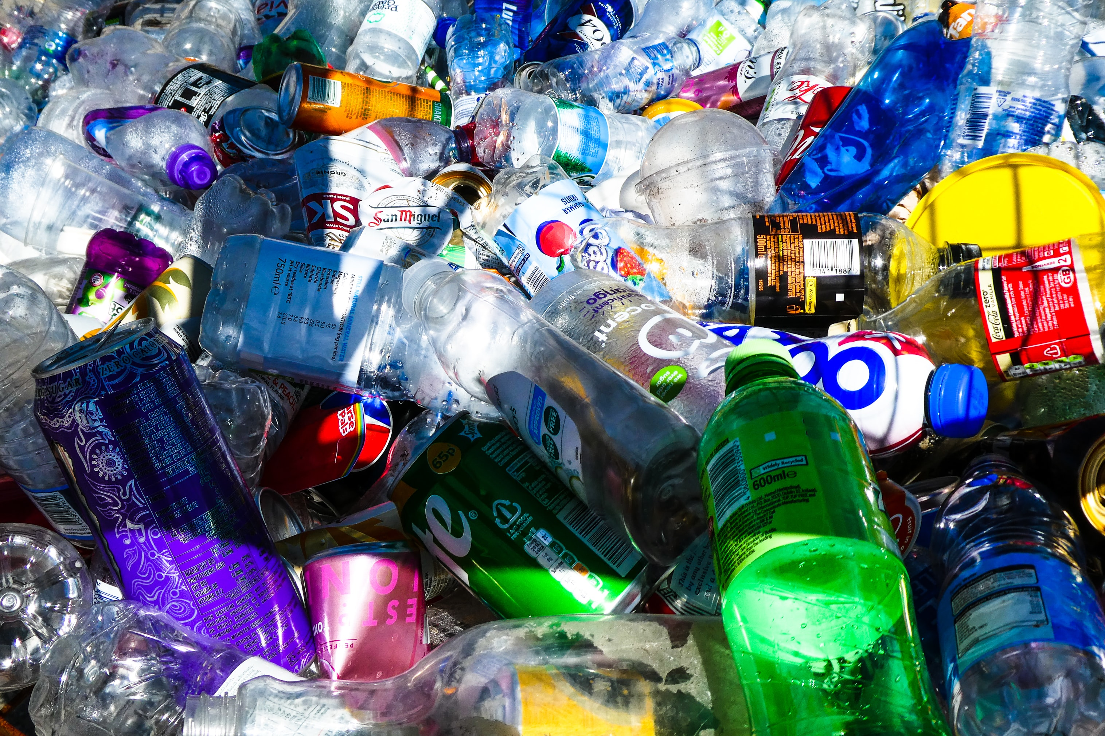
Refuse, reduce, reuse, repair, recycle, rot
Notes:
Refuse Reduce Reuse Repair Recycle
Everything we use has an environmental impact. An environmental impact is when something we use changes nature and our world. Everything we use has a different environmental impact. Driving a car burns fossil fuels which cause carbon dioxide to enter our atmosphere, this adds to the greenhouse effect and then this causes to climate change. You can learn more about this in our Greenhouse Effect Worksheet.
Things we use can have other environmental impacts too. For example products made from plastic can end up in our ocean and damage sea life.
We need to think about the things we use and use less things which have a negative or bad impact.
One way to think about the things we use is to look at the 5 Rs : REFUSE, REDUCE, REUSE, REPAIR, RECYLE
Let’s look at them in more detail:
Refuse: Say no to what you don’t need
The best way to reduce the environmental impact of what we use is to consider if we need to use it at all.
Ask yourself “Why am I buying this item?” or “Why do I need this?” For example, make a personal commitment to say NO to plastic bottles. Whenever getting a drink use your refillable bottle and refuse a drink if you know it is in plastic.
Reduce: Only buy things when you really need them
Do you really need those new trainers or do the ones you have still fit? Do you already have toys at home you can use rather than buying new ones? Can you walk instead of getting in the car?
Reuse: Using something again
Reusing things can save time and money as well as energy and materials. For example, you could fill old food jars with leftovers. Use library books which are reused all the time instead of buying a book that will only be read once. If you get a present, you can take off the wrapping paper carefully and use it again.
Repair: Before you buy something new see if you can repair what you have
If your cardigan is missing a button then buy a button and sew it on instead of buying a new item. If something is broken at home ask if it can go to a repair shop and be fixed rather than replacing the whole item.
If we repair more things we own they last longer and we are not having to create as many things which damage the environment.
Recycle: Making materials into new materials and objects
You’ve probably recycled before. Maybe by putting your cereal box in the paper bin. Recycling is when our rubbish gets turned into new products. You might notice some plastic bottles and paper being made from recycled materials.
Unfortunately, most of our waste doesn’t get recycled. The government says 45% of our waste gets recycled which still means that most goes to landfill or is burned. Thousands of tonnes of our household plastic packaging which we put in our recycling bins ends up in waste incinerators in the UK where it is burned releasing lots of nasty chemicals into the air.
Some people say the amount of things getting recycled is even lower than 45% because more than half of our plastic recycling in sent abroad where some plastic waste we think is being recycled is actually dumped or burned illegally. Plastic that has been dumped can end up in our oceans where it harms animals and pollutes the sea.
Recycling is really important when it is done correctly but remember it is also important to refuse, reduce, reuse and repair before we consider recycling.
Sometimes you might see a 6th R for Rot. You can put old food scraps like banana skins and tea bags in a compost bin where they will break down into compost. If you have a garden, then a worm farm is a fun way to rot your food waste. The worms will break down your food in no time and produce worm juice when they wee and poo which is really good to put on plants and help them grow.
Remember though we should try and reduce our food waste by only buying what we need, eating up things before they go of and finding ways to eat things we might normally throw away. For example cauliflower leaves can be roasted or eaten in a curry and spring onion end can be places in soil where they will grow into new spring onions within a fortnight.

Slide 15
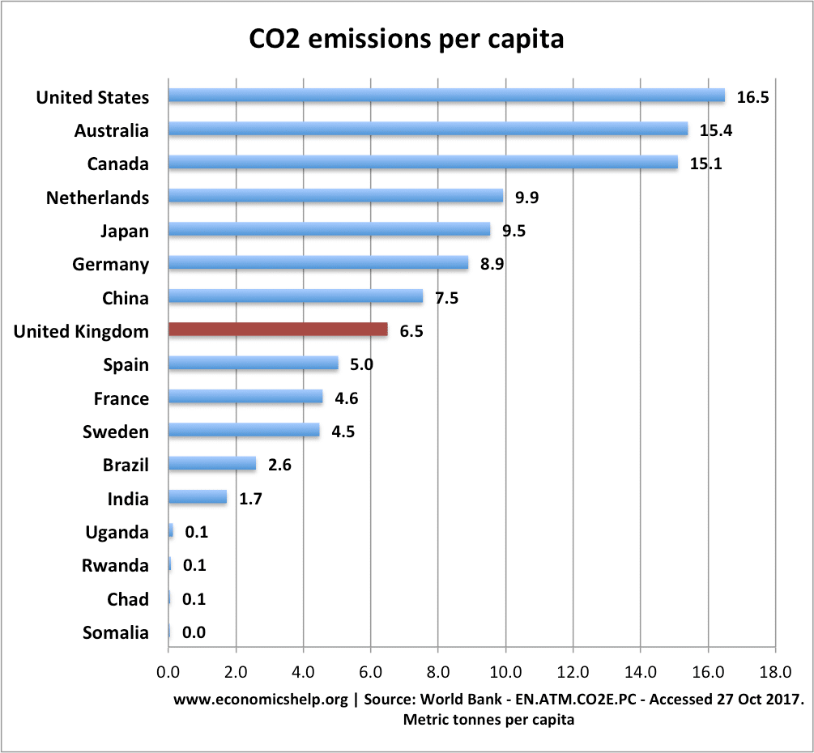
Work our your carbon footprint
Notes:
You might have heard that it is a good idea to reduce your Carbon Footprint. But what is a Carbon Footprint? A Carbon Footprint is the total greenhouse gas emissions greenhouse gas emissions caused by something. Greenhouse gasses are what is making our planet warmer and causing climate change. Your carbon footprint is a number which shows the amount of carbon dioxide your greenhouse gas emissions equal. Places, companies, and events can have carbon footprints too. So the school can have a carbon footprint made up from how much electricity it uses, the school dinners we eat and the items we use like paper and pens. Anything that creates greenhouse gases can be included in your total carbon footprint. For example a pen that was created in a factory that burns fossil fuels has a carbon footprint even if we can’t see the fossil fuels that were used when we look at a pen. It’s the same with food – a ham sandwich might not seem like it would have a carbon footprint but even things like transporting the ham from the farm to the shop will use fossil fuels. WORK OUT YOUR CARBON FOOTPRINT

Slide 16
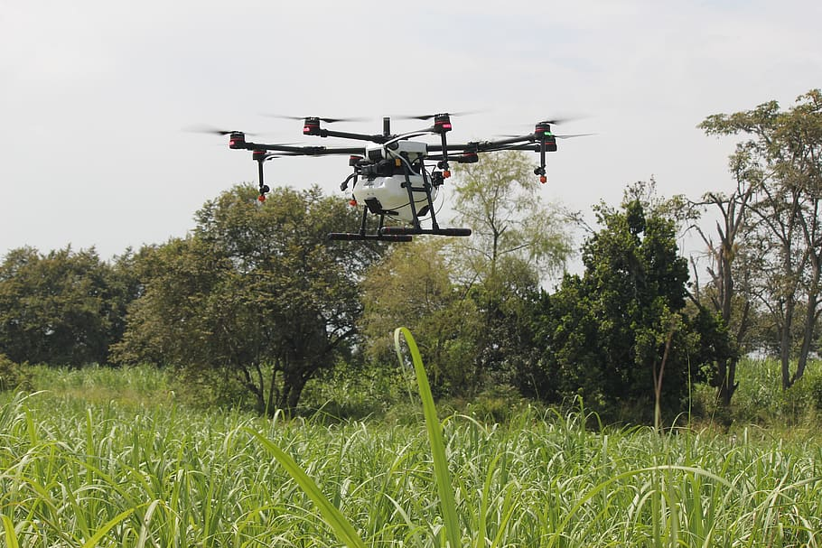
What are scientists doing?
The first lab grown beef burger (uncooked)
A drone helping plant trees
Notes:
What are scientists doing?
Scientists are always trying to find new ways to help our planet and some are really interesting!
Scientists are looking at pumping CO2 from the air into porous rock formations where it can remain safely for thousands of years. Reportedly, up to 90% of emissions could be captured but the technology is very new and still being tested.
One of the more ‘fun’-sounding solutions, giant water cannons at the poles have been proposed by a physicist in the US. This would involve installing millions of water cannons to shoot seawater onto the surface of the ice sheets where it would refreeze and thereby thicken the ice.
Drones that plant trees a recent study suggested that the most effective method to combat climate change is simply to plant trees — at least a trillion of them, in fact, all around the world. Apparently, we have the space to do this but to achieve the necessary scale, we may need a robotic hand.
Lab grown meat…The idea behind it is that producing ‘traditional’ meat for the entire world requires a huge amount of water, land and feed , plus cows trump greenhouse gases!— The UN is encouraging more plant based diets as a means to combat climate change but not everyone wants to swap their cottage pie mince for lentils so lab grown meat could be the answer. Would you eat a lab grown chicken nugget for your school dinner?

Slide 17
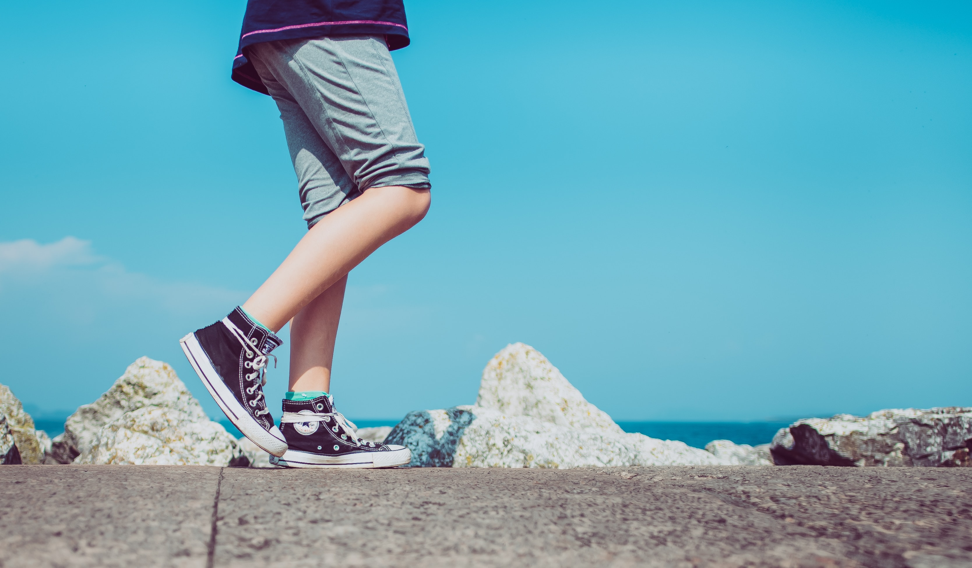
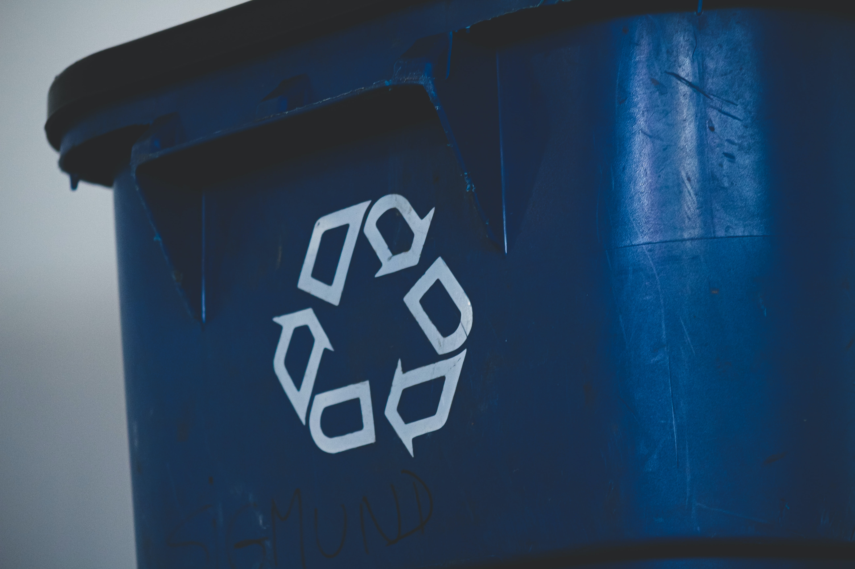
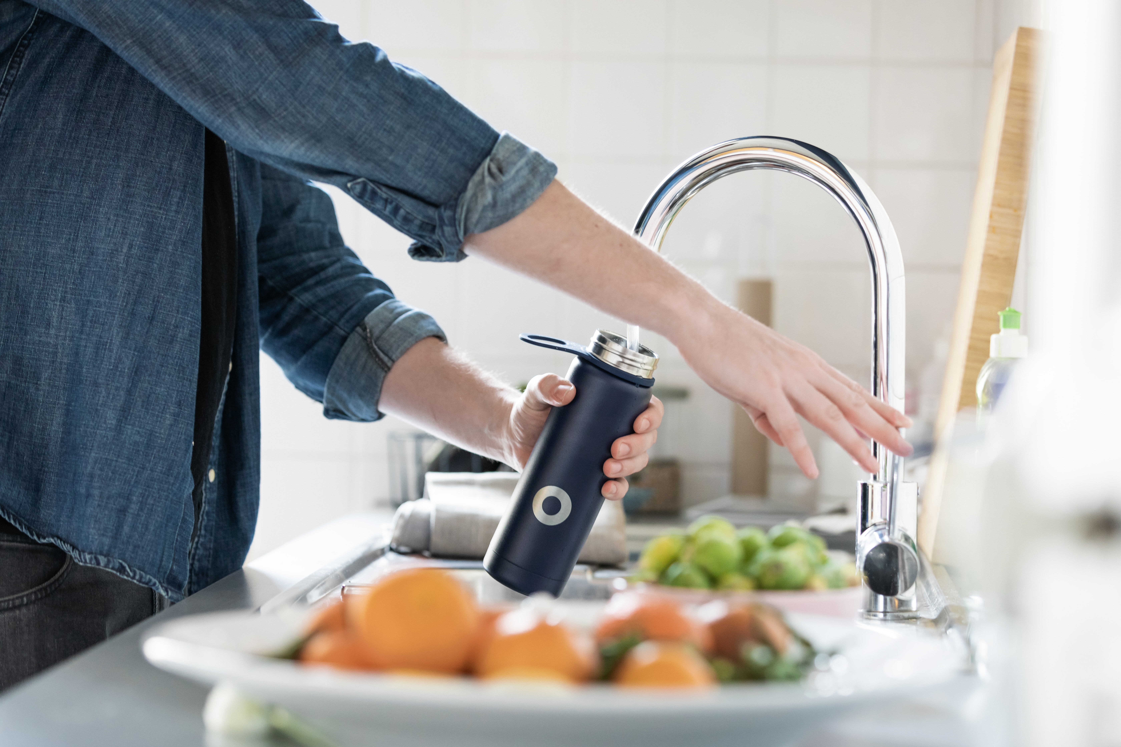
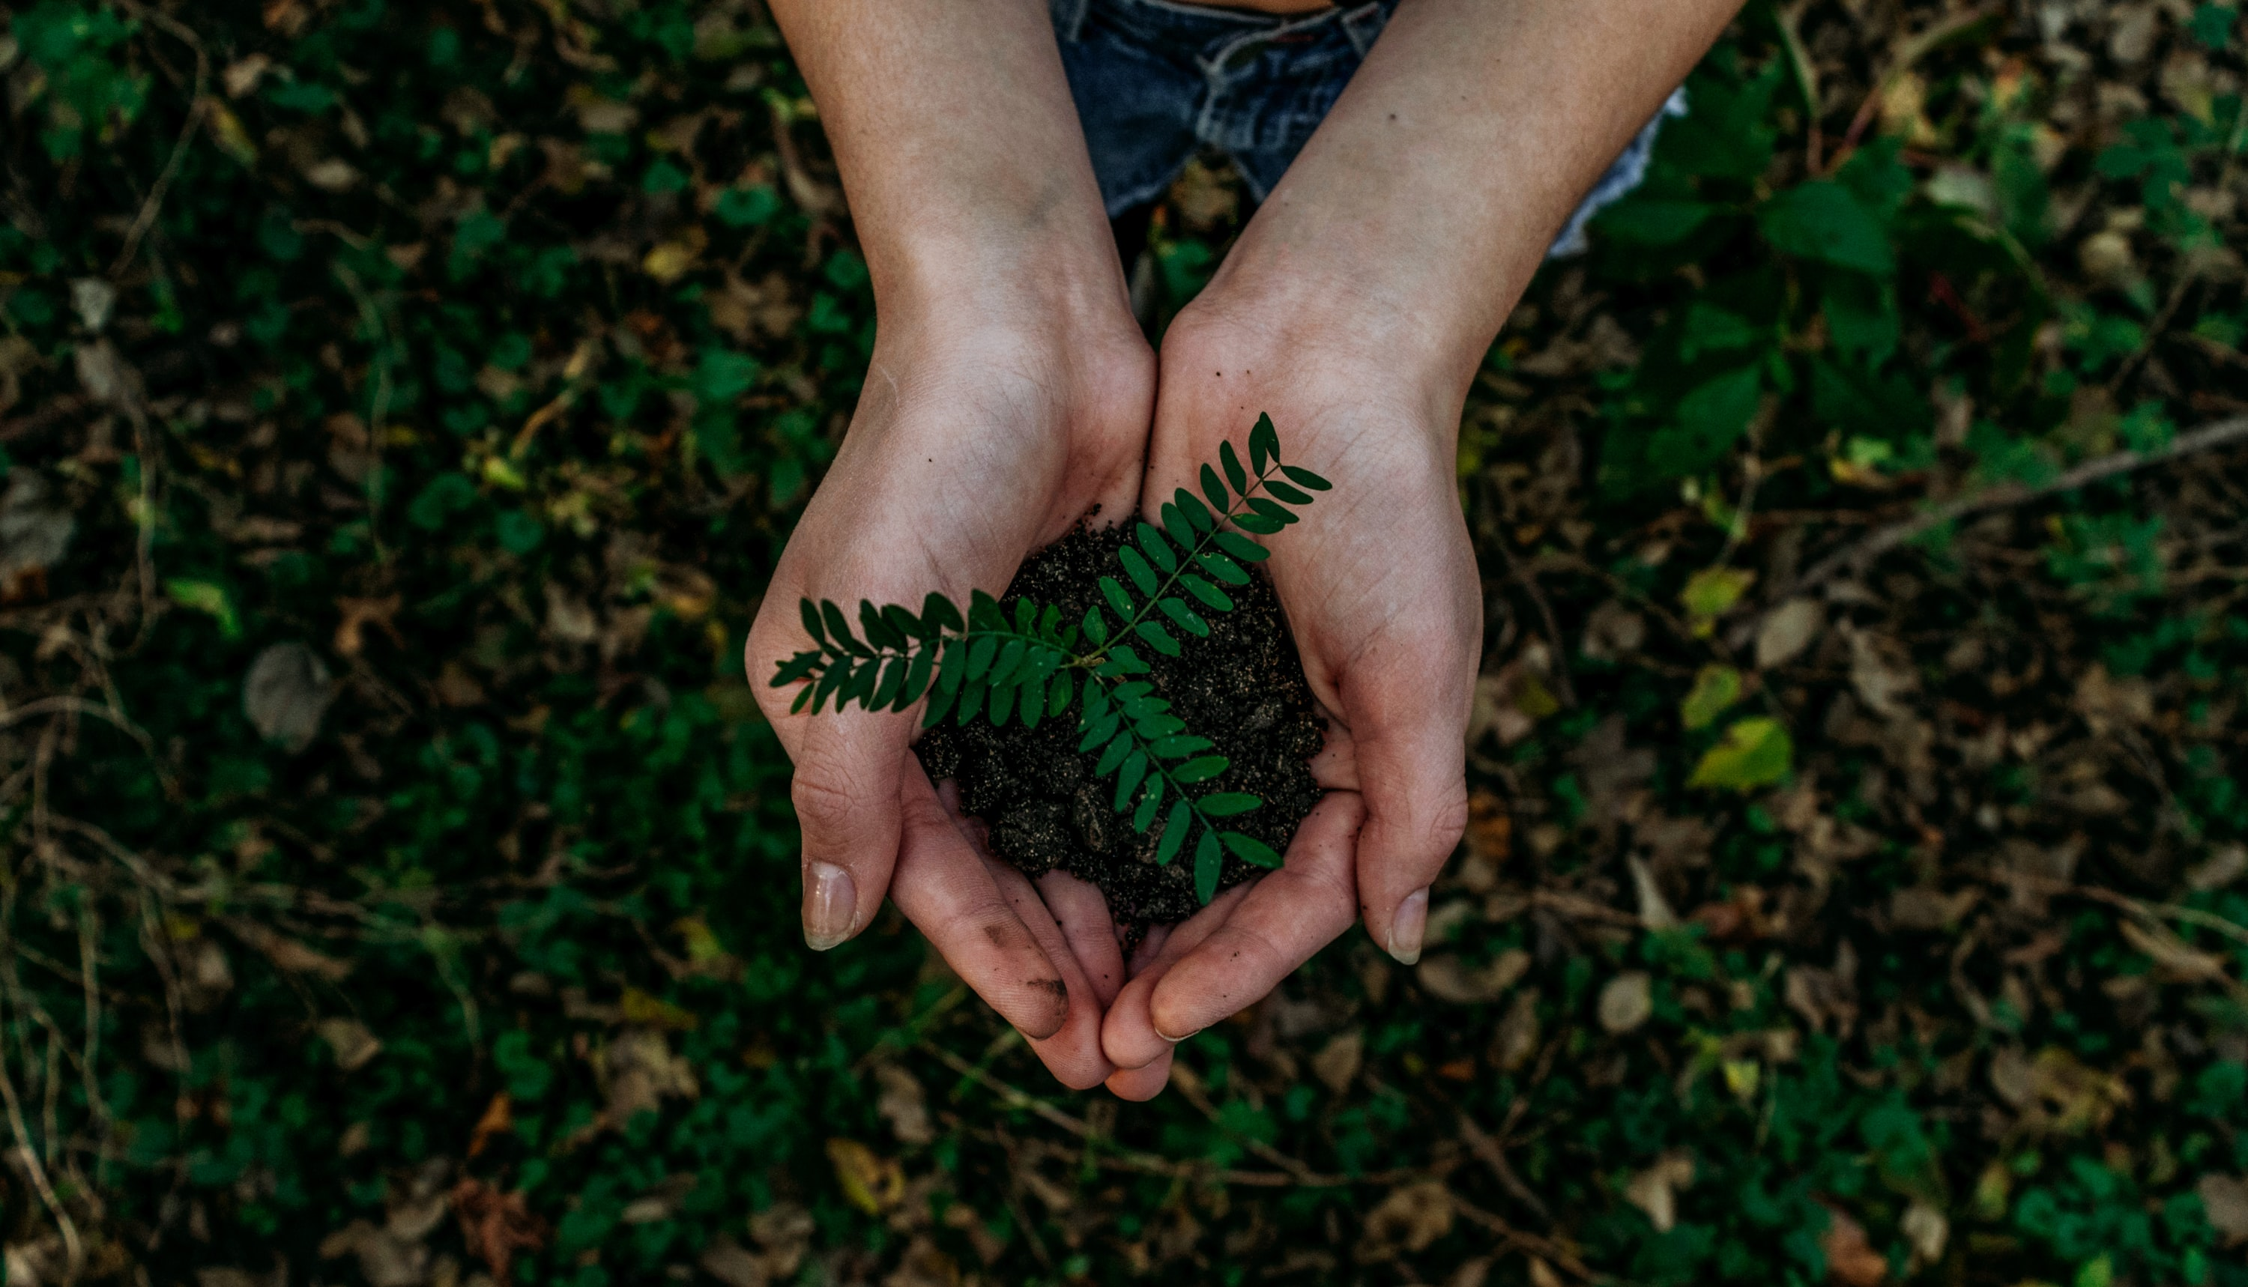
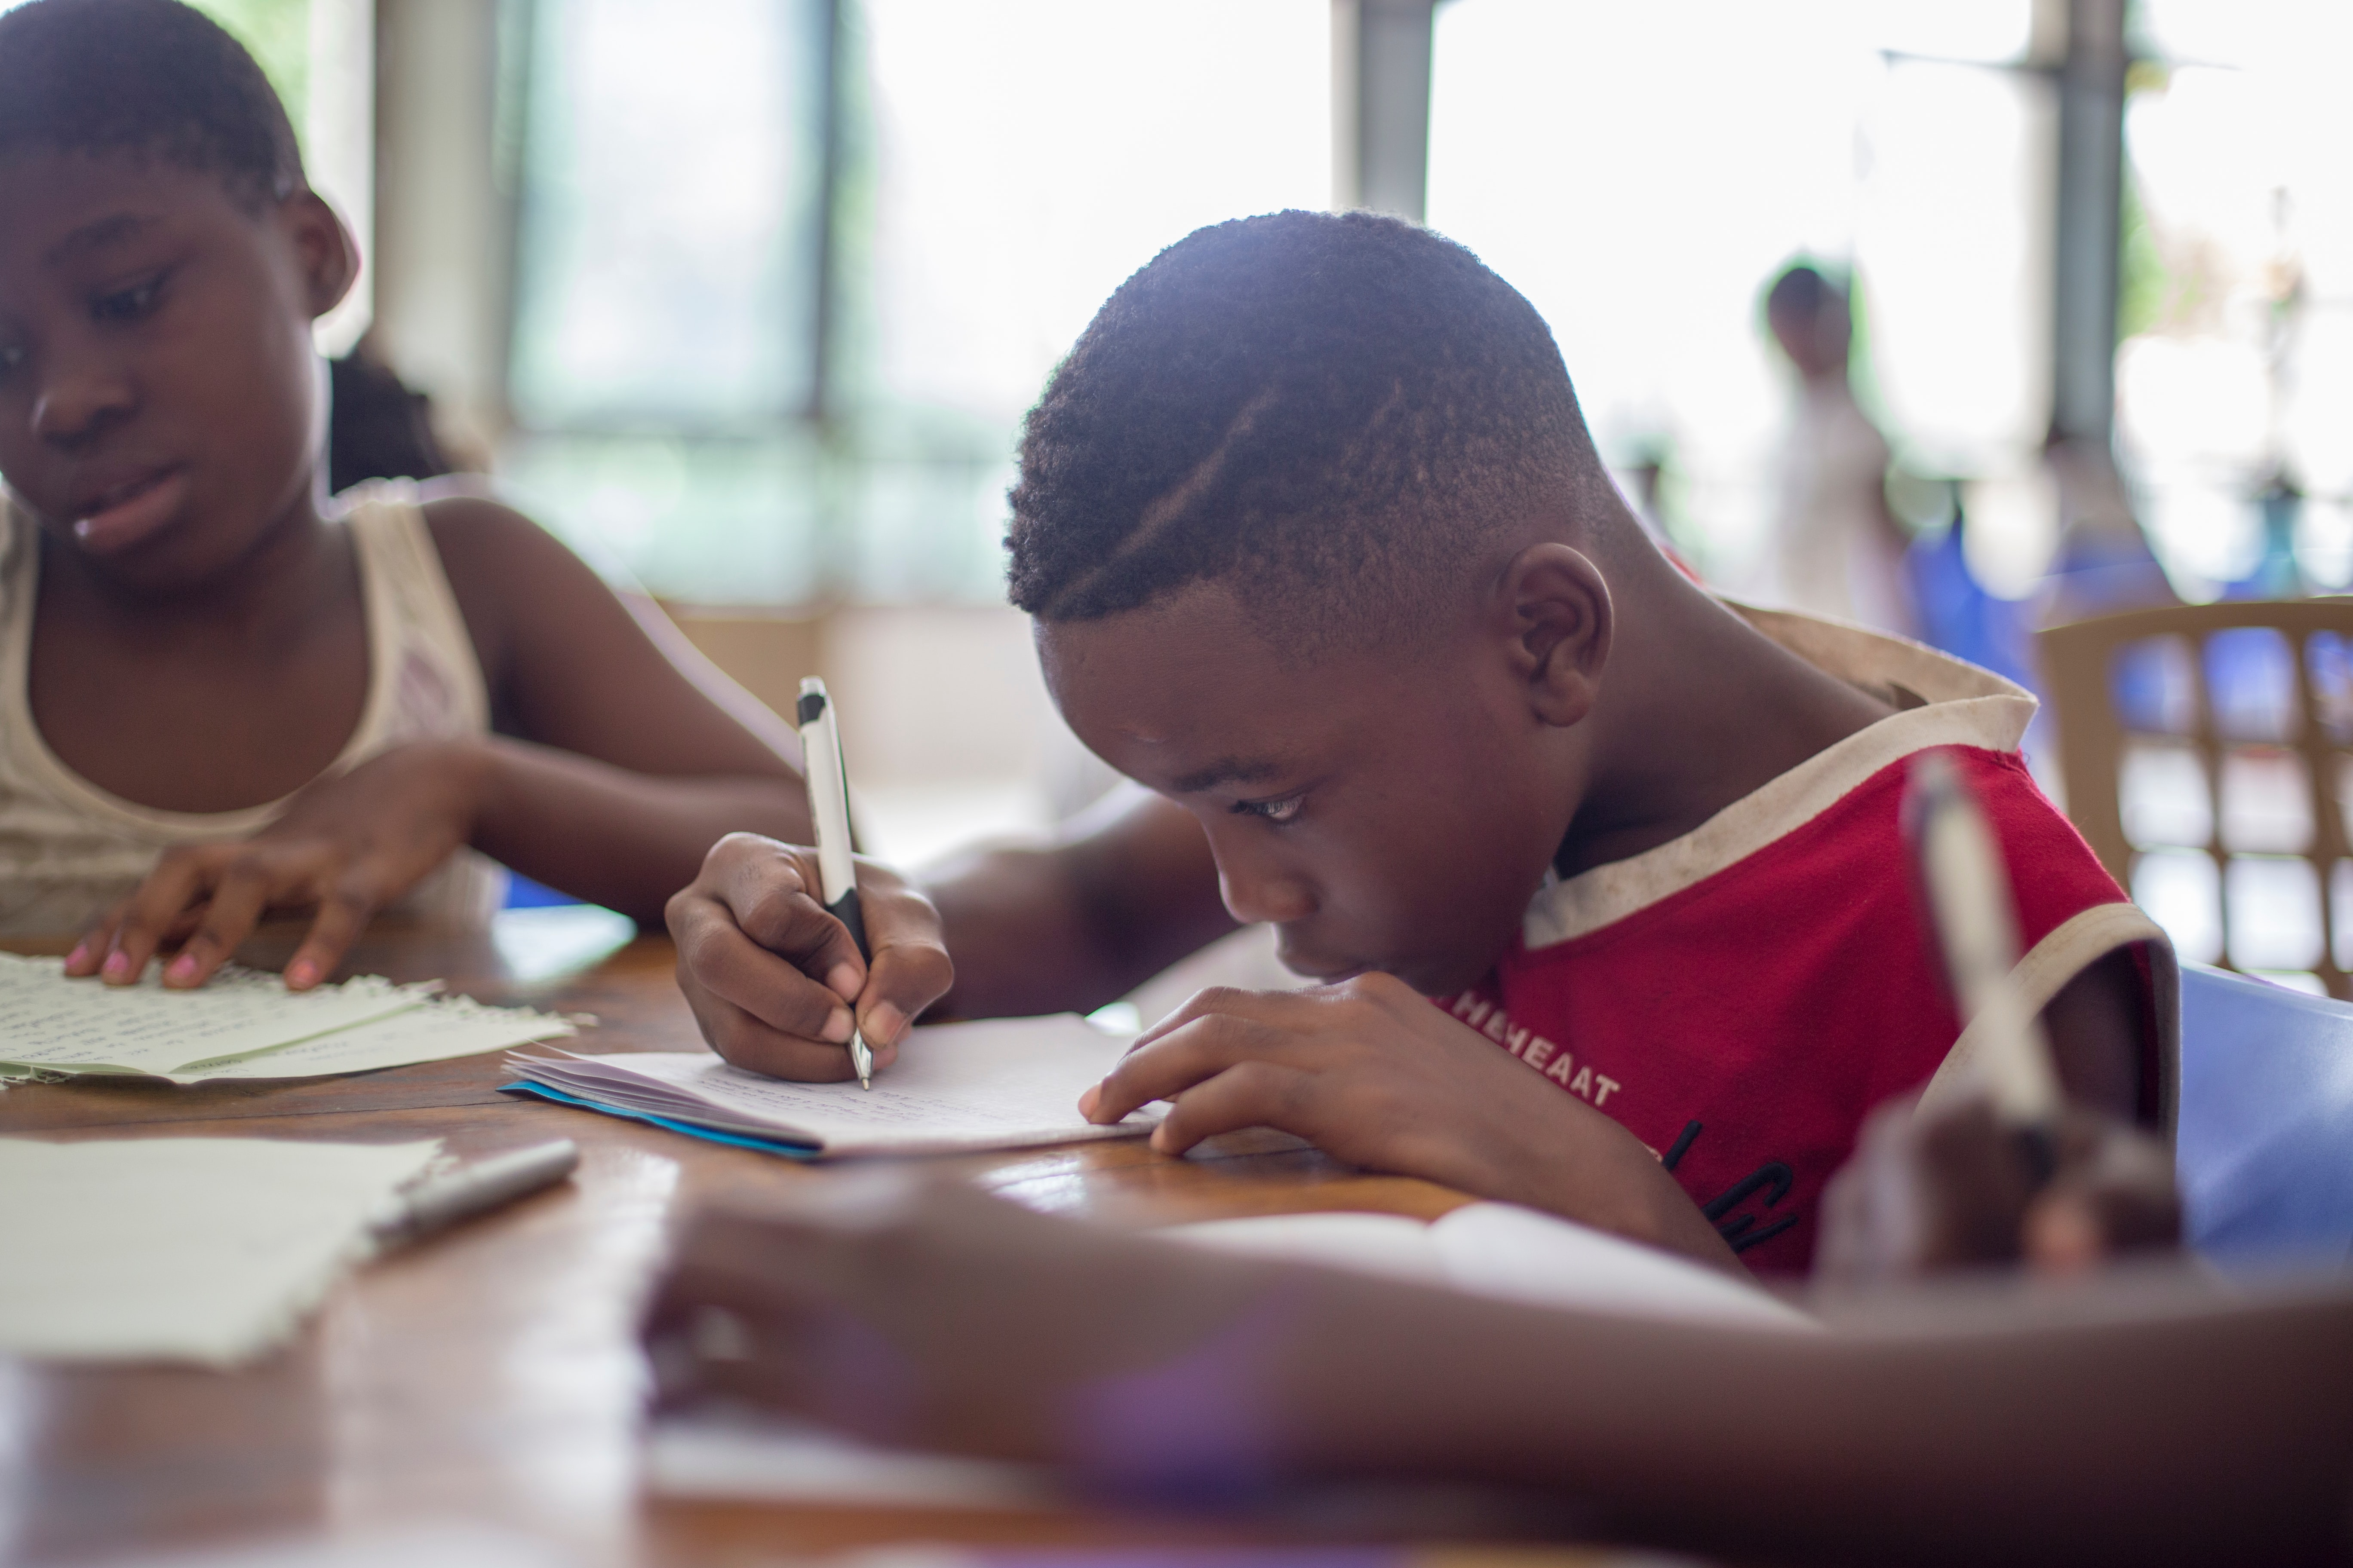
Let’s become
Eat less meat
Walk to school
Have a bake sale for a charity which helps people impacted by climate change
Make sure your class is recycling
Switch off the lights
Use a reusable bottle
Refuse, Reduce, Reuse, Repair, Recycle, Rot
Plant a tree
Write a letter to your MP about climate change
Fix something instead of buying new
Notes:
Let’s all be Fun Kid’s Climate Heroes!
Choose at least 1 action from the list to become a climate hero!
Walk to school instead of going in the car OR if you live to far away to walk think about sharing the journey with a friend so that only 1 car is used instead of 2.
Make some changes to what you eat…Go veggie for lunch and pick the meat free option for your school dinners. Or if you like cooking swap out your chicken for a sweet potato this week or your beef for chickpeas.
Only use a reusable bottle – this cuts down on single use plastic (which often ends up where we don’t want it to be – the ocean) and the carbon emissions it takes to bottle the water and transport it to the shop.
Write a letter to your MP or the government telling them why climate change is an important issue
Write a letter to a company you think needs to make changes to help stop climate change – you might need to do some research on companies first but think about some of the things we have found out contribute to greenhouse gases and write to a company you think should try and change this.
Become the unplugger and be a superhero by going around your house unplugging things that aren’t being used like chargers and toasters .
Plant a tree! Trees breath in Co2 and turn it into oxygen so the more trees we can plant the better.
Have a bake sale for a charity which protects the rainforest or helps those who have been affected by climate change
Become a recycling hero and make sure your class is recycling things properly! You can also make sure that your class draw on both sides of the paper and paper that is thrown out is used for crafts.
Challenge yourself to plastic free packed lunch – swap the juice carton for a bottle of water or squash, have your sandwiches in a reusable box instead of cling film and have a loose apple instead of wrapped fruit or crisps.
Optional: You could get each class compete to try and cut down on their CO2 habits and be a climate hero…swaps for the planet could be walking to school, veggie school dinner, plastic free packed lunch, buying 2nd hand clothing rather than new, use the bus where you’d normally go in the car, recycle…you can give out points depending on how big a change they are making and remind children that even when the challenge ends they planet still needs us to carry on making changes.
Make it clear that changes need to be stuck to if we want to help planet.
KS1 adaptation: Each class is going to make a Pledgehog. Write a pledge on a hedgehog prickle and add it to the class hedgehog it might be remembering to turn off lights, telling a family member about how important protecting the planet is or making a poster to remind people to do X to help our planet and putting it up in school/ a shop etc.
KS2 Extension task : Write a letter to someone of influence (persuasive writing task that could fit in with existing work for some years) asking them to make changes….could be your MP, asking a parent/ grandparent to change habits, a business you think could do more to recycle or the headteacher asking if they can make a change within the school. Think about how you can persuade them to make the change you want to see – think about why they should care and what they can do.

